Slide 1
Tutorial

Slide 2
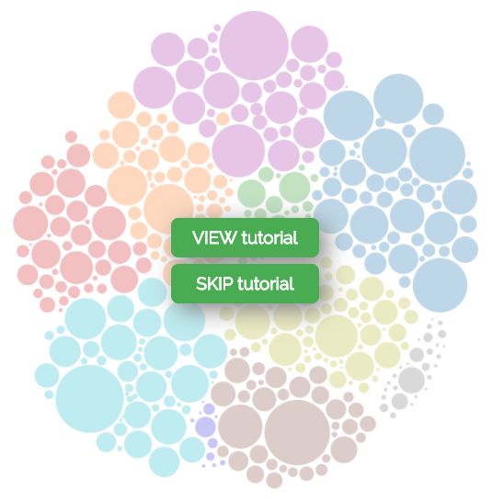
Pave
Is a Canadian
Job Explorer

Slide 3
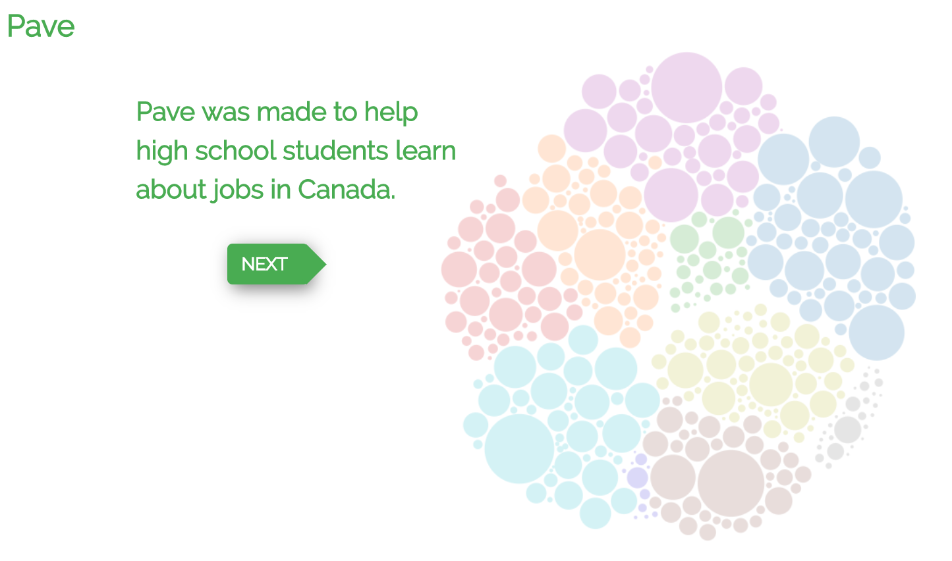



Pave
Tutorial 1 of 5
Pave was made to help simplify career decisions for high school students.
Is a Canadian
Job Explorer

Slide 4


You can use Pave to quickly compare many different careers.
Tutorial 2 of 5

Slide 5
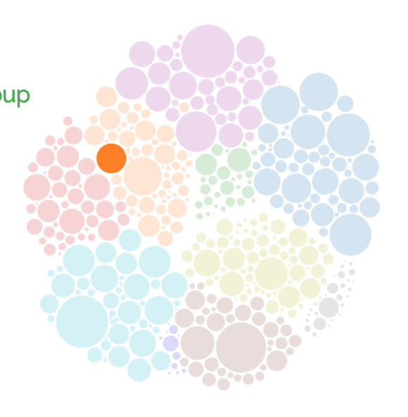

The circles on the right represent job groups. Hover over the circles to see the job group details.
Tutorial 3 of 5

Slide 6
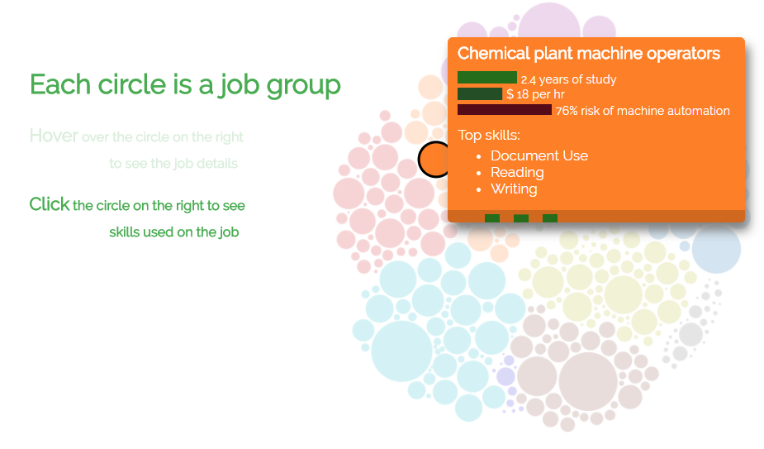

The circles on the right represent job groups. Hover over the circles to see the job group details.
Tutorial 3 of 5
manufacturer

Slide 7
Each circle represents a job group Hover over the circle on the right to see job details Click the circle on the right to see skills used on the job
Tutorial 3 of 5
manufacturer

Slide 8


Each circle represents a job group Hover over the circle on the right to see job details Click the circle on the right to see skills used on the job
Tutorial 3 of 5
manufacturer

Slide 9


Each circle represents a job group Hover over the circle on the right to see job details Click the circle on the right to see skills used on the job
Tutorial 3 of 5
manufacturer
More stuff?!

Slide 10

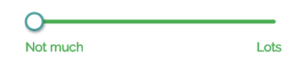
The skill sliders let you look at jobs that use different amounts of various skillsets.
Move the slider handle below to “Lots” to see which jobs use more math skills.
Tutorial 4 of 5

Slide 11
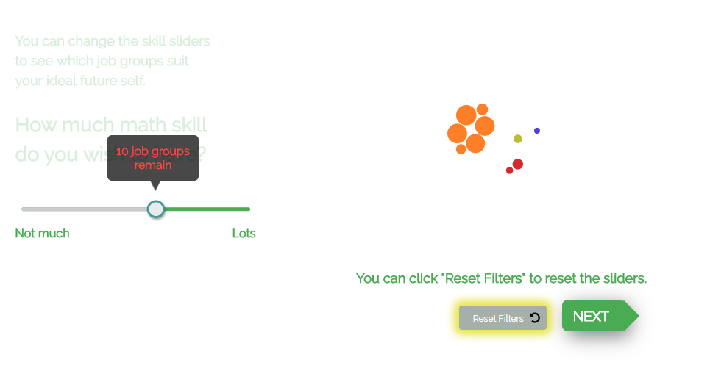
The skill sliders let you look at jobs that use different amounts of various skillsets.
Move the slider handle below to “Lots” to see which jobs use more math skills.
Tutorial 4 of 5

Slide 12

Tutorial 4 of 5

Slide 13
Tutorial 4 of 5

Slide 14

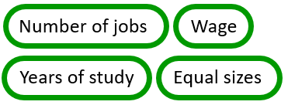
Tutorial 5 of 5
Size by:
options

Slide 15

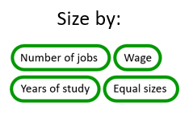

Tutorial 5 of 5
options
Number of Jobs

Slide 16
Main page

Slide 17
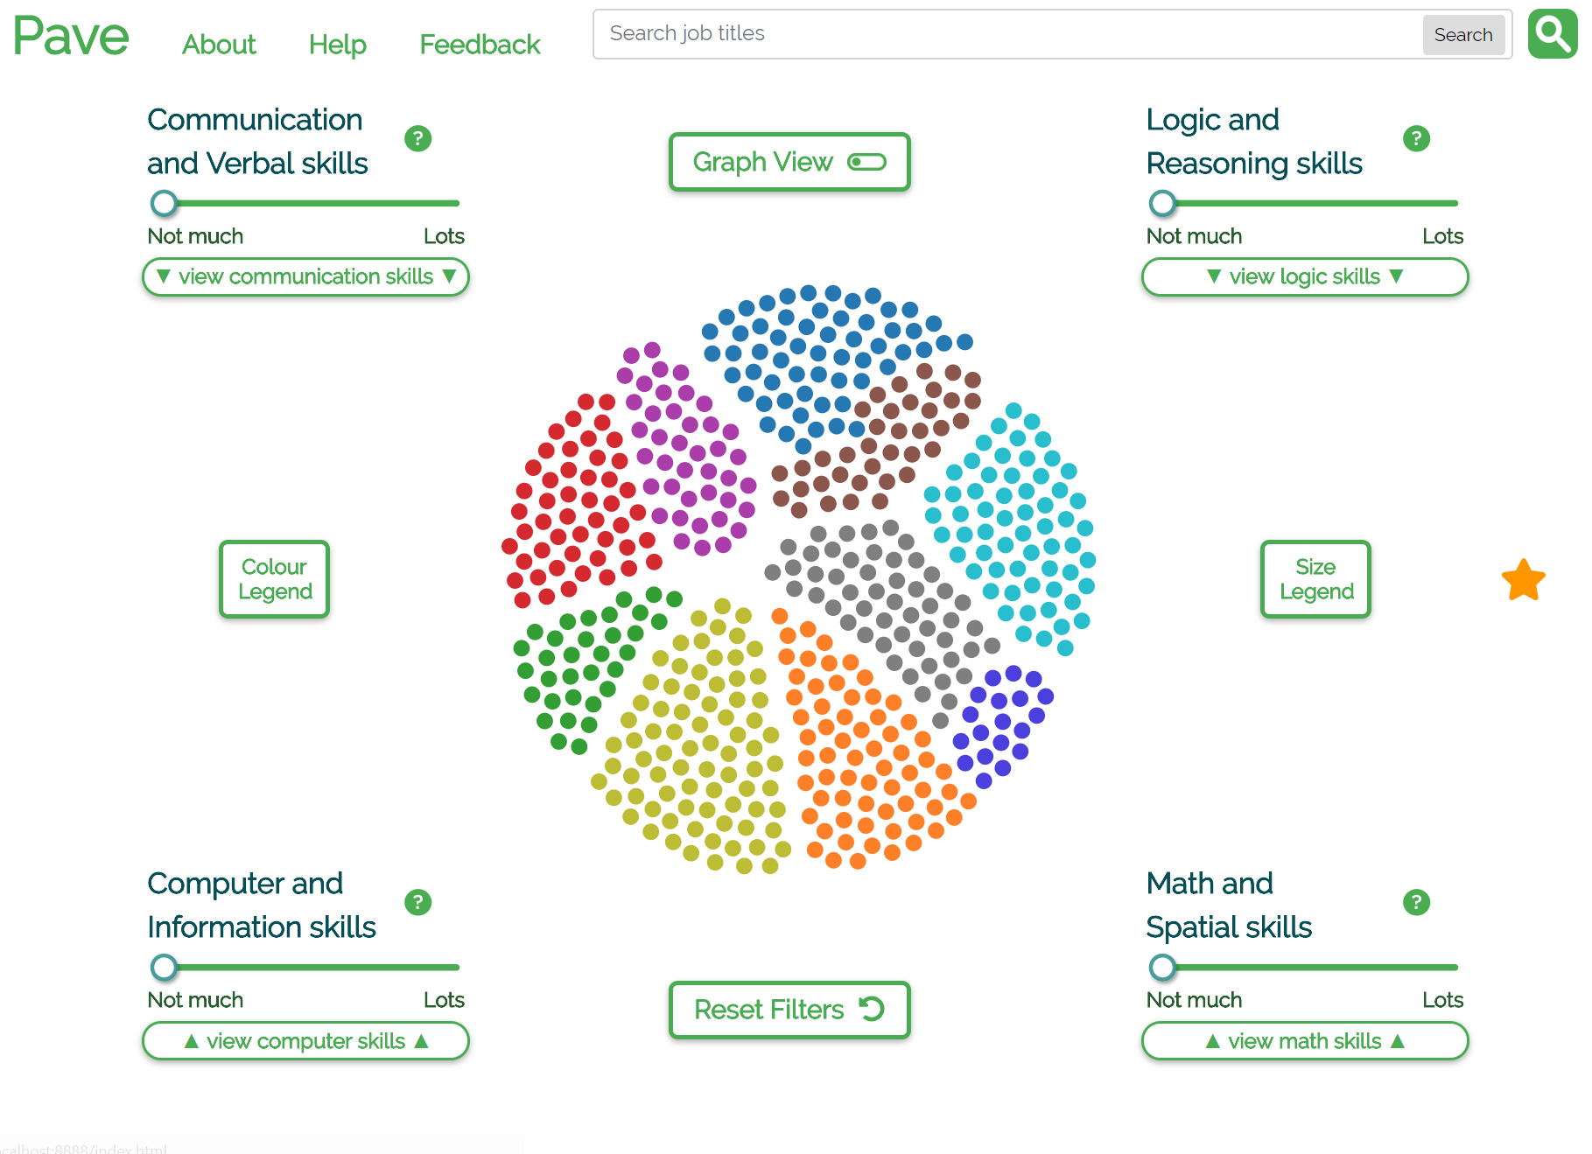
New verbose skill titles (with “inactive text” colour)

Slide 18
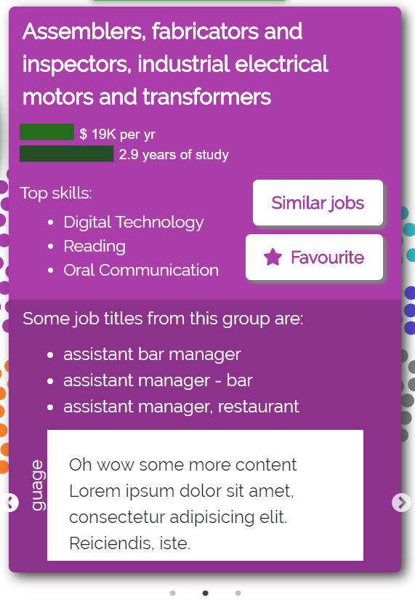
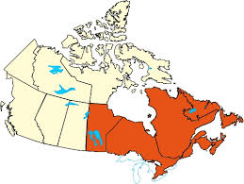
Tooltip currently contains 3 carousel slides (most important first):
Filled map of available program locations (+ tuition cost and/or years of study?)
Zoomable job stats & x/5 star rating
?
1
2
3
Can I do this?
Should I do this?
How do I do this?
Schools & locations (maybe a filled map?)
Average GPAs
Prerequisites
Ratings out of 5 stars
How likely am I to get this job
Job outlook
Input, output, in/out ratio
School websites
Online courses
Volunteer opportunities
Job postings?

Slide 19
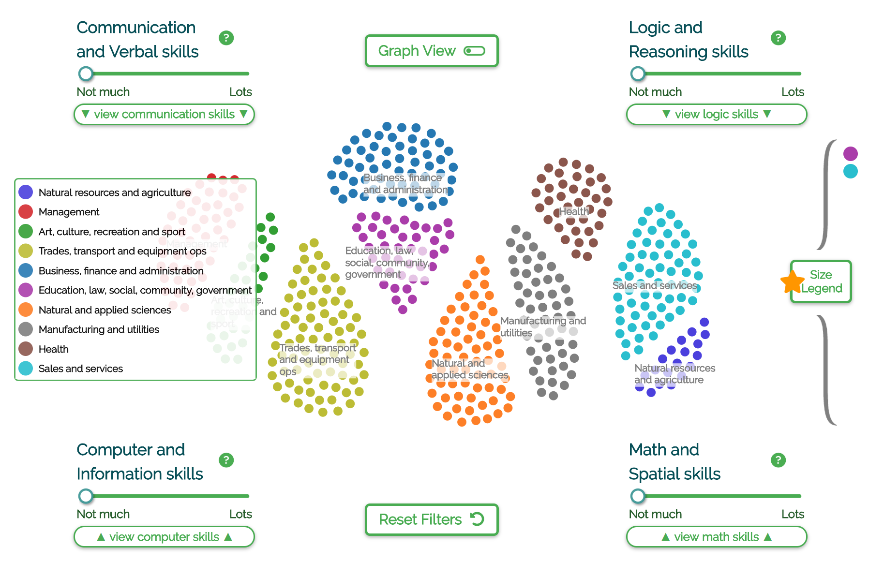
Colour legend with centered labels (should favourites collapse on colour legend click?)

Slide 20
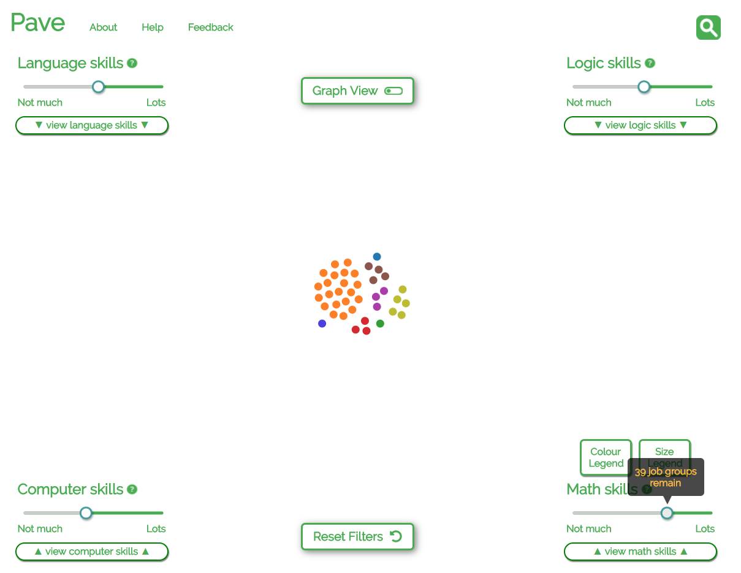

Slide 21
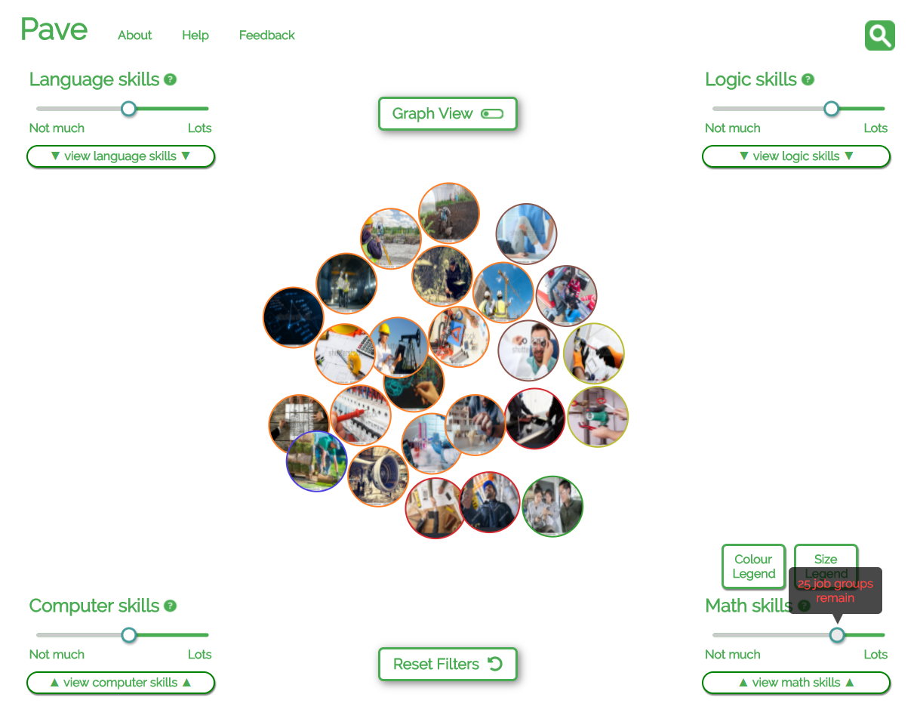

Slide 22
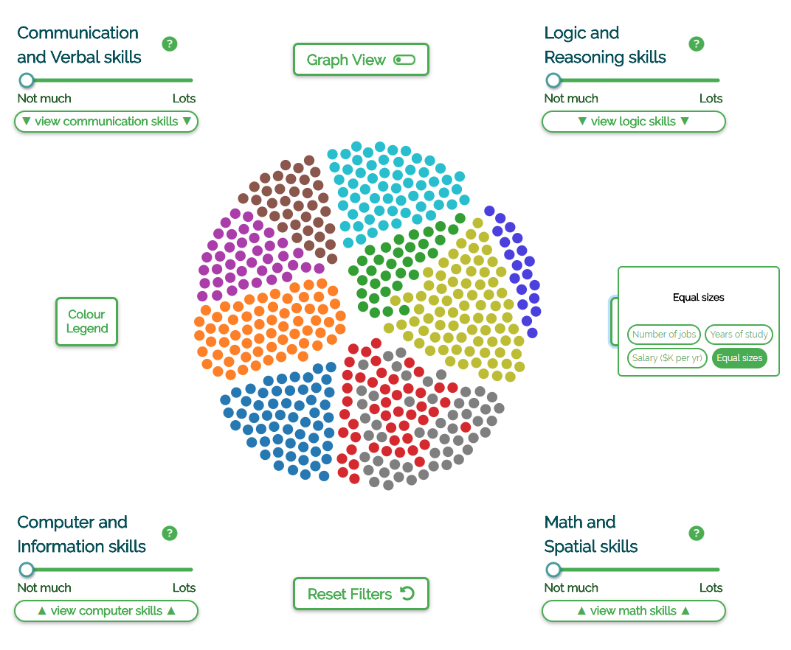
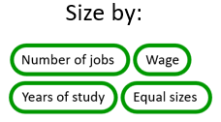

Slide 23
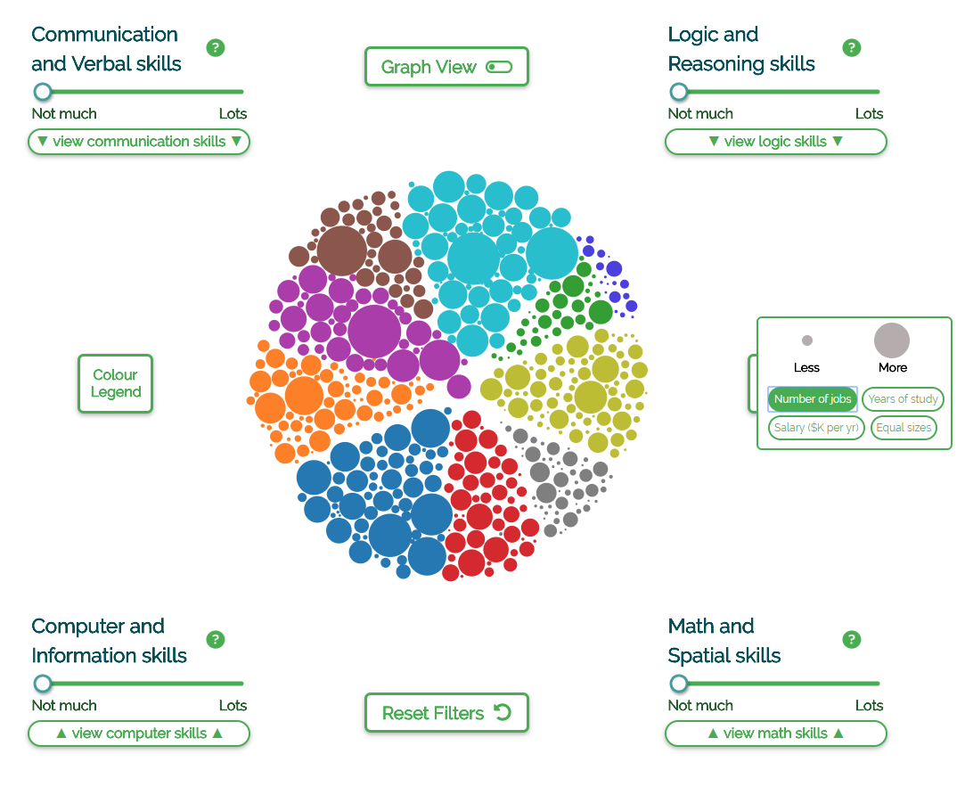

Slide 24
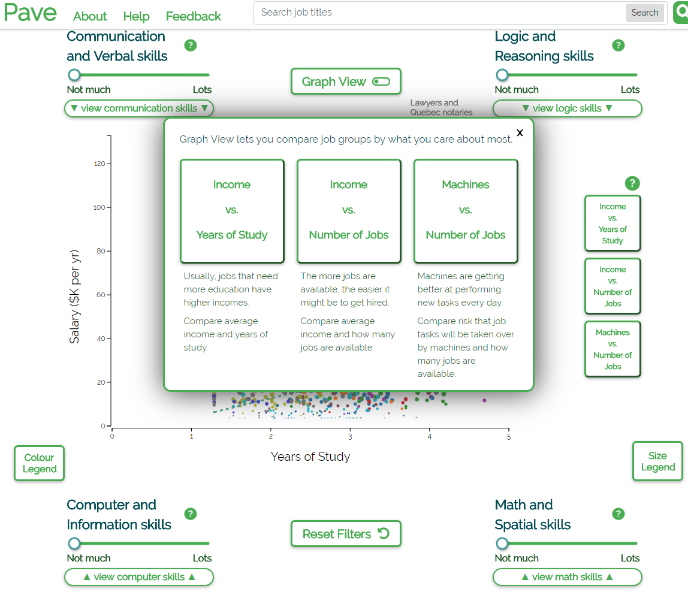

Slide 25
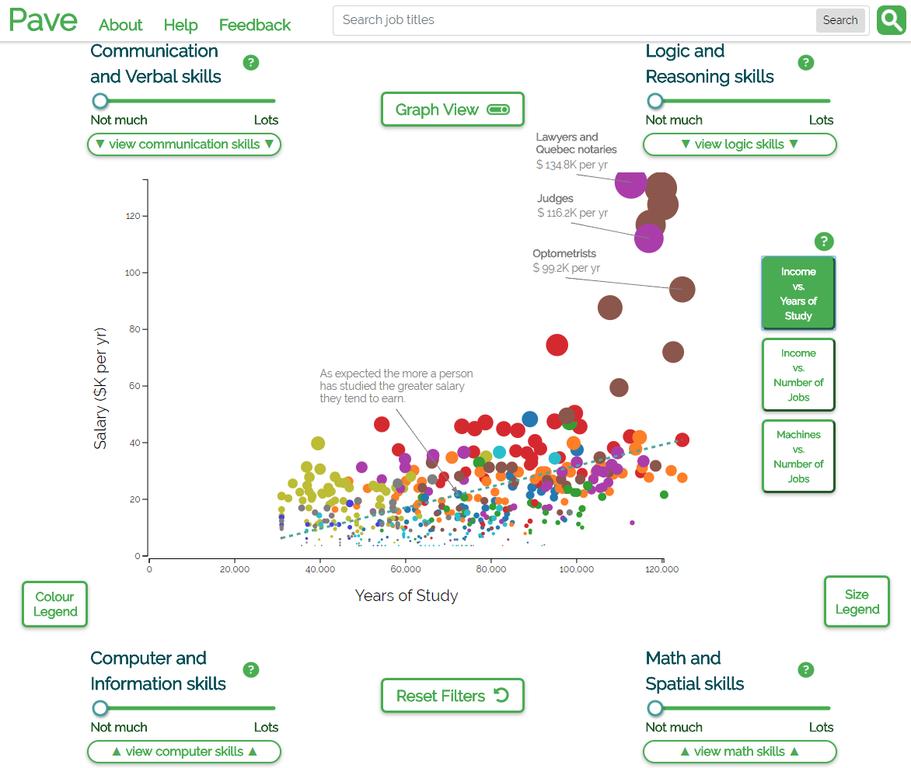

Slide 26
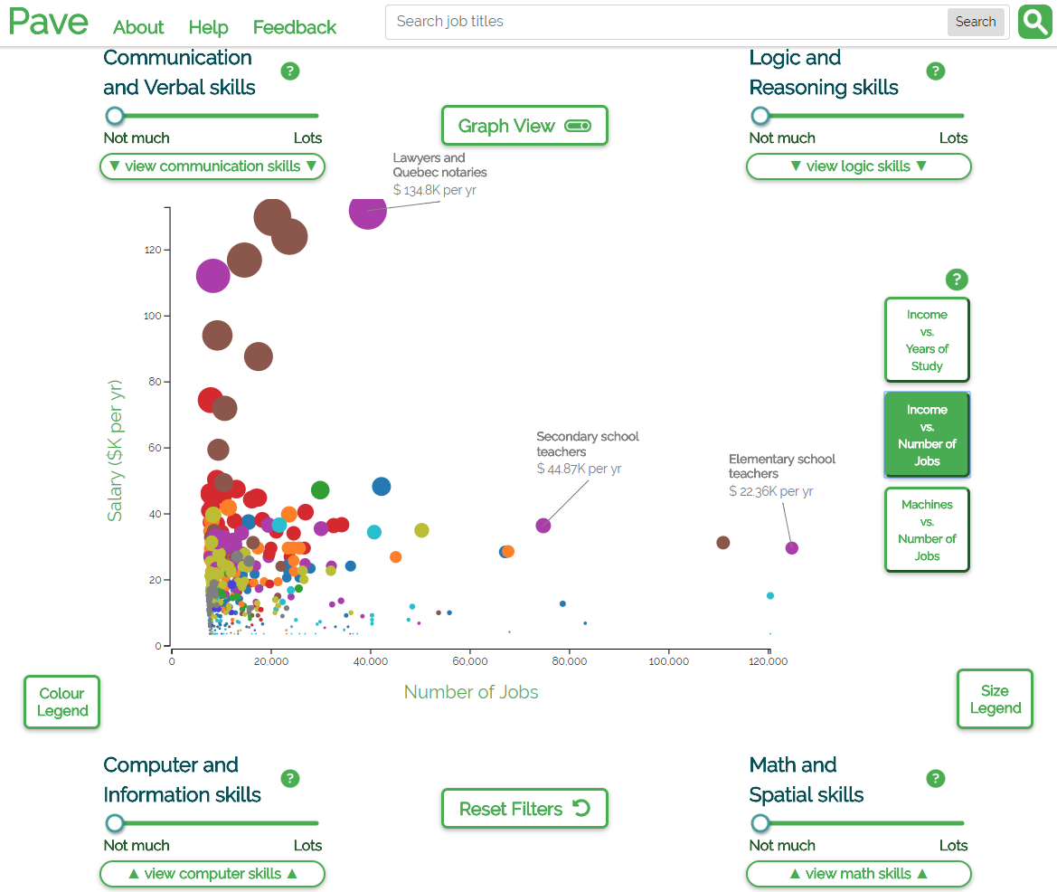

Slide 27
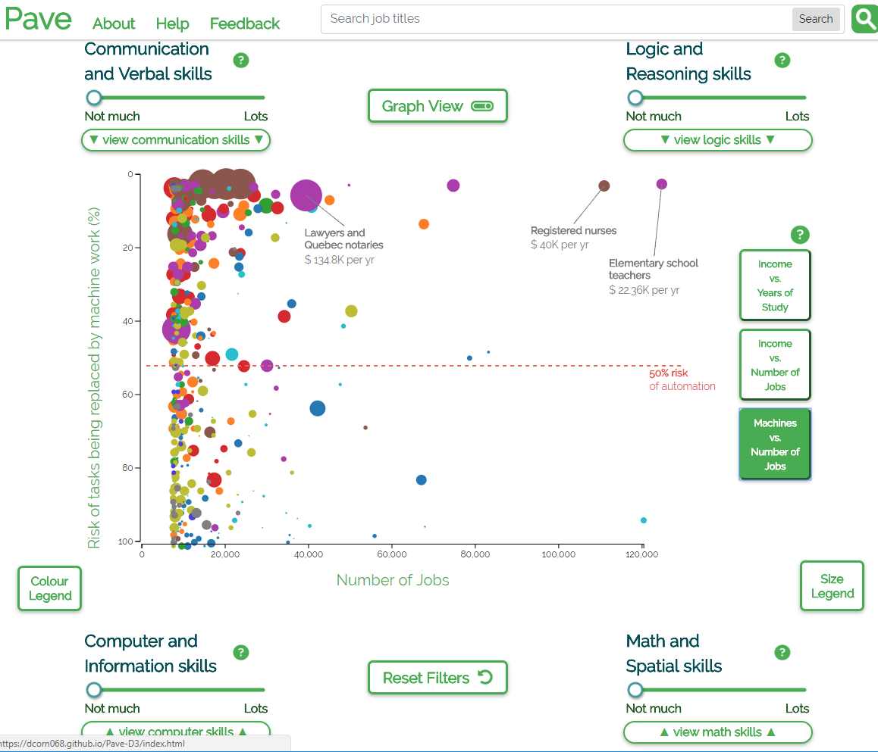

Slide 28
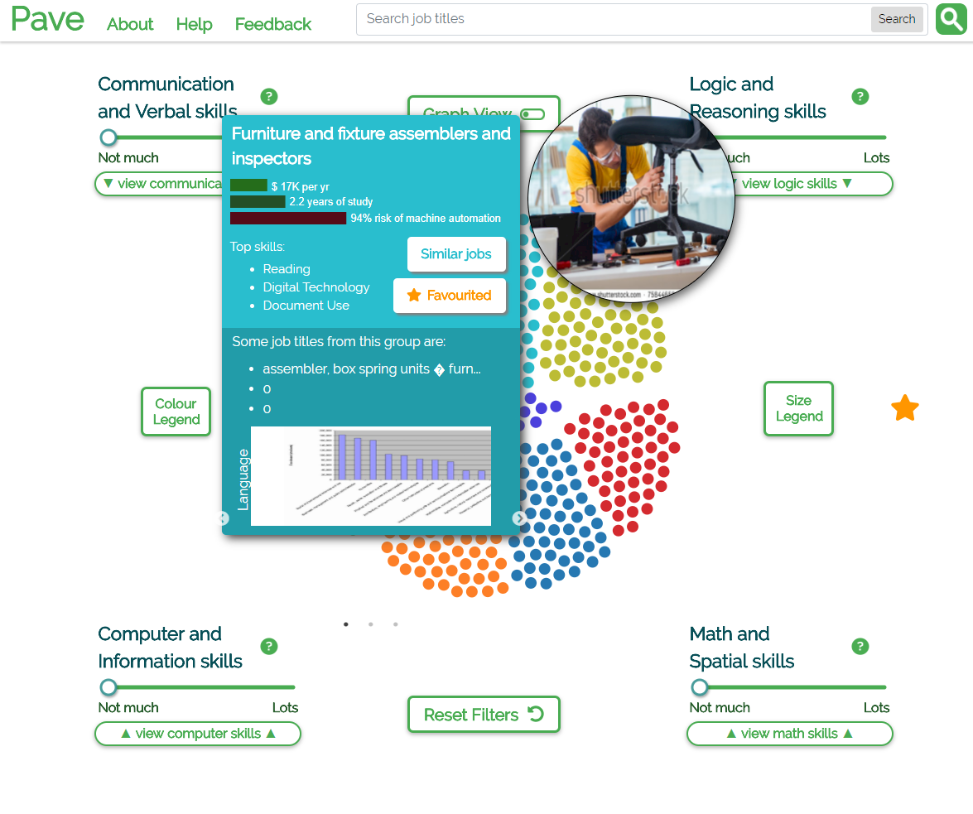
Favourites panel on the right

Slide 29
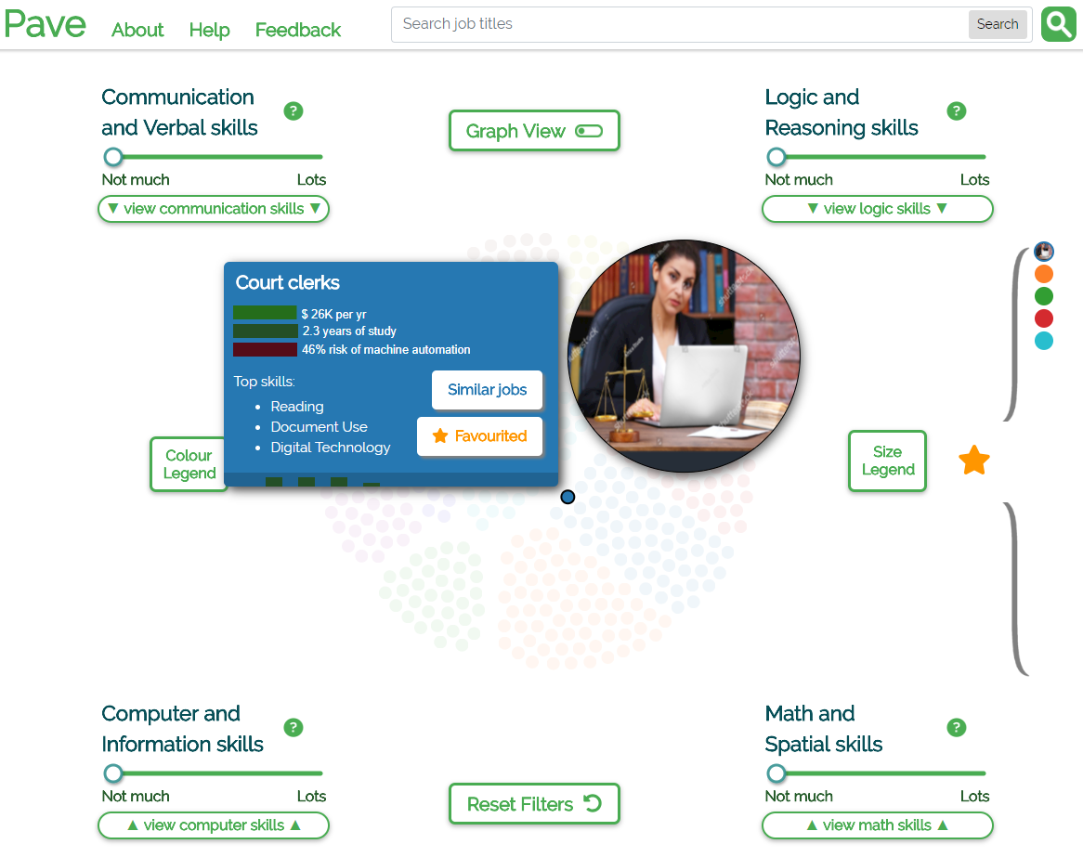
Hover in the favourites panel to highlight favourites

